Slide 1
Victoria’s Path to Treaty
Stakeholder Information Pack

Slide 2
Acknowledgement of Country
We acknowledge the Traditional Owners of Country throughout Victoria and pay our respect to First Peoples, their culture, and their Elders past and present.

Slide 3
How to use this presentation
Information in this presentation has been developed by the Victorian Government Department of Premier and Cabinet, First Peoples - State Relations.
This presentation has been developed for Victorian Government stakeholders to use and adopt.
The presentation contains information about Victoria’s Path to Treaty.
Speaking notes are included as a guide.
If you are presenting to your organisations about Victoria’s Path to Treaty, please feel free to copy presentation content to your own PowerPoint templates.
Information in this presentation is accurate as at February 2025.

Slide 4
Contents
Part 1 – Our history, our present
Part 2 – Treaty in Victoria
Part 3 - Where we are going

Slide 5
Our history, Our present
Part 1

Slide 6
What is Treaty
A negotiated agreement between two parties.
Each treaty is unique. It’s based on the interests and needs of the negotiating parties.
Victoria is the first state to negotiate a Treaty in Australia.
All Australian states and territories have commenced work on self-determination.
Notes:
We are at an exciting moment in history. After nearly a decade of preparation – getting strong foundations in place – in Victoria, the Victorian Government has commenced statewide Treaty negotiations.
A Treaty agreement is an agreement that is negotiated between two parties. There are many different types of treaties. ​
Each treaty is unique and negotiated based on the interest and needs of the parties involved. ​
Treaties between First Peoples and governments have been signed in other jurisdictions including New Zealand and Canada. ​
The Victorian Government have learned from the treaties made in other countries, but are negotiating a Treaty that is unique for Victoria.​
Other Australian States and Territories are working to progress First Peoples’ rights but Victoria is the most progressed with its work on Treaty and truth

Slide 7
Why the Victorian Government is negotiating Treaty
Throughout our history, First Peoples have been excluded from social and economic opportunities.
Treaty is a practical way for First Peoples to have a say about the policies that impact First Peoples’ health, housing and education.
Laws and policies work best when people affected by them have a say in how they work.
Notes:
The Victorian Government is on this path because throughout our history, First People have been excluded from social and economic opportunities.
Treaty gives us a pathway to change what isn’t working – to give First Peoples a say on the policies that impact their lives.
In Victoria we have been on the Truth and Treaty path for more than eight years.
The Victorian Parliament has passed legislation twice, developed policies, and made commitments across every level of government to progress Treaty.

Slide 8
Context for Victoria’s Treaty
In 2014 the Victorian Government conducted Treaty talks across the state.
In 2016 the Victorian Government announced commitment to Treaty.
Victorian Government spent the past 9 years putting the foundations in place.
Productivity Commission 2024 report shows insufficient progress on closing the gap.
Treaty and Truth, led by First People is the best way to deliver reforms to close the gap.
​
Notes:
In 2014 the Victorian Government held a listening tour and spoke with First Peoples across the State. They told government that policies worked best where services were community controlled.
In March 2016, the Victorian Government announced its commitment to discuss Treaty with the Victorian Aboriginal Community.
Productivity Commission data released in 2024 that showed Victoria’s performance on Closing the Gap is mixed. Our progress on some targets has gotten worse in recent years. We have the highest rate of Aboriginal children in out of home care. ​
The Productivity Commission has recognised the importance of Treaty and truth processes in addressing these poor results (there’s more information on this in the Volume 1 - Study report - Review of the National Agreement on Closing the Gap)
We won’t close the gap until Aboriginal people can make decisions about the policies that impact their lives. Self-determination is how we can start to address the systemic barries that contribute to the gap. ​
When we look across the State we can see proof of this. Community controlled Aboriginal-led services are getting the best results – whether that’s in childcare or health services. ​

Slide 9
Foundations for Victoria’s Treaty
Two Acts of Parliament passed.
Key foundation elements established:
Representation (the First Peoples’ Assembly of Victoria)
The Rule Book (The Treaty Negotiations Framework)
The Umpire (The Treaty Authority).
Underpinned by truth telling - Yoorrook Justice Commission.
Notes:
Victoria was the first Australian jurisdiction to put the foundations in place to negotiate Treaty. Importantly, they decided to take it slow, lay solid foundations and set the process up to succeed.
The Victorian Parliament passed a law which set out how Victoria would pursue Treaty.
The foundations the Victorian Government has put in place:
the Representatives - the First Peoples' Assembly of Victoria
the rules for Treaty - the Treaty Negotiation Framework
the Treaty umpire - the Treaty Authority
And finally, what is being done to understand the truth about our past and plan our future - the Yoorrook Justice Commission’s truth-telling.

Slide 10
Telling the Truth about Victoria’s history
Our history impacts our present.
To overcome inequality, we need to understand how it was created, and how it continues.
Government policies and practices have created an opportunity gap that still exists today.
Notes:
Our history impacts our present. To overcome inequality, we need to understand how it was created, and how it continues.
There’s been a long silence about colonisation and its impacts on First Peoples, including the role that government policies and practices played in creating an opportunity gap that still exists today.

Slide 11
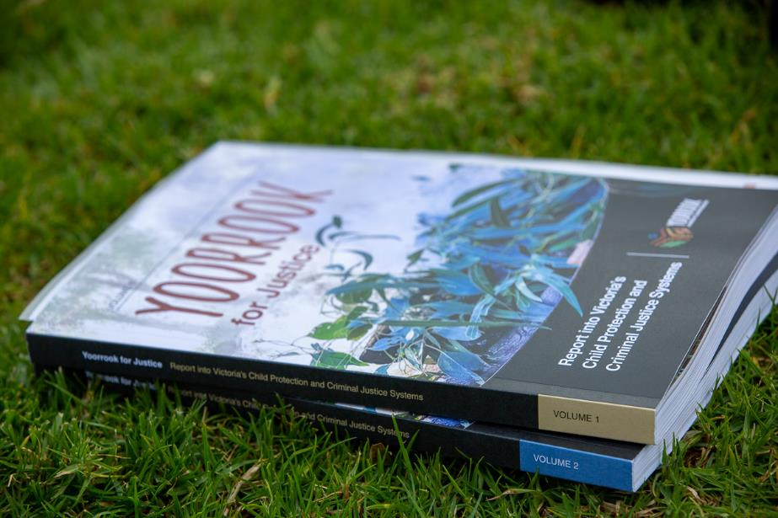
The Yoorrook Justice Commission
Australia’s first formal truth-telling process into historical and ongoing injustices experienced by Aboriginal people in Victoria.
Has held Inquiries and gathered evidence since 2021 – two interim reports.
Will deliver final report by 30 June 2025.
Establishing an official public record so we can develop a shared understanding about Victoria’s history.
Notes:
The Victorian Government, in partnership with the First Peoples' Assembly, established the Yoorrook Justice Commission, Australia’s first formal truth-telling process.
This is the first formal truth-telling process into historical and ongoing injustices experienced by First Peoples in Victoria.
Many Government Ministers and witnesses gave evidence before the Commission to tell the truth about the injustices committed against First Peoples in Victoria since colonisation.
Commission hearings have been an opportunity to hear of the strength, resilience and resistance of Aboriginal people – of their unbroken connection to culture and Country for tens of thousands of years.
The Commission will produce an official public record that will help us understand Victoria’s history.
The Commission’s work will inform the Treaty negotiation process.

Slide 12
Treaty in Victoria
Part 2

Slide 13
The Representative – First Peoples’ Assembly of Victoria
The First Peoples’ Assembly is the independent and democratically elected body to represent Traditional Owners and First Peoples in Victoria.
Established in 2019 under Treaty legislation, it has had two elections.
Assembly Members represent communities across 5 regions: Metropolitan, South East, South West, North East and North West and 13 Traditional Owner groups.
For more information, visit: firstpeoplesvic.org
Notes:
The First Peoples’ Assembly of Victoria is the independent, democratically elected body representing Traditional Owners and First Peoples in Victoria. It has been operating since 2019 and established by law in Victoria.
It is made up of 33 Traditional Owners of Victoria to ensure it represents the diversity of the state. Every region of the state has representation.
The Assembly has now been through two elections. The current co-chairs are Ngarra Murray and Rueben Berg.
The Assembly also has an Elders’ Voice, recognising the cultural strength and guidance of Elders. It has a Youth Voice, acknowledging the need to listen to and engage the next generation.
The First Peoples’ Assembly has worked with the Victorian Government to establish the elements necessary to support Treaty negotiations.

Slide 14
The Rules – Treaty Negotiation Framework
The Treaty Negotiation Framework lays out the rules for how Treaties will be negotiated:
Who can negotiate a Treaty.
What can be in a Treaty.
How the process will work.
How other parties could be involved.
How disputes will be handed, and treaties implemented.
Available publicly here: Treaty Negotiation Framework | firstpeoplesrelations.vic.gov.au
Notes:
The Treaty Act sets out the rules for what needs to be covered in the Treaty Negotiation Framework.
This Framework was negotiated with the Assembly. It was released publicly in 2022.
The Treaty Negotiation Framework is the core rulebook that guides how the State and representative parties will engage in Treaty negotiations, and how the Victorian Government will address issues that arise and resolve disputes.
It’s publicly available and can be viewed on the First Peoples-State Relations website.
It contains all the detail, the ins and outs of how the negotiation process will work.
The Canada treaty process had a similar rulebook, to make sure the whole process was open, transparent and structured.
The Treaty Negotiation Framework will guide the Victorian Government in all future agreement-making as required under Victoria’s Treaty law.

Slide 15
The Umpire – Treaty Authority
The Treaty Authority is the independent umpire overseeing Treaty negotiations.
Nation-leading institution, First Peoples-led.
The Treaty Authority ensures the process is fair for all negotiating parties.
Notes:
The Treaty Authority and Other Treaty Elements Act 2022 (Treaty Authority Act) was passed with bipartisan support in August 2022.
The Waitangi Tribunal in New Zealand is an example of this kind of body.
The Treaty Authority has been set up with 5 members and is the independent umpire overseeing Treaty negotiations.
The Treaty Authority ensures the process is fair for all negotiating parties, according to the rules set out in the Treaty Negotiation Framework.
The Treaty Authority launched the Treaty Negotiations Database on 1 July 2024.
The Database is the official register of all parties engaging in Treaty negotiations. It will hold information on which parties are involved in Treaty negotiations, as well as what is being negotiated and the status of negotiations.

Slide 16
Treaty negotiations have commenced
Treaty negotiations commenced with a ceremony at Darebin Parklands on 21 November 2024.
Notes:
Treaty negotiations commenced with a ceremony at Darebin Parklands in Fairfield on Wurundjeri Country on 21 November 2024.​
​
Aboriginal Victorians came together from across the state to share culture. ​
​
The Premier of Victoria, the Governor of Victoria and members of the Victorian Parliament attended, as well as Yoorrook Justice Commissioners, members of the Treaty Authority. ​
​
We’re going to play a short 60 second video about the event.
Link: https://vimeo.com/1036230078/c0bd49c942

Slide 17
Statewide and Local Treaties
In Victoria, two types of Treaties will be negotiated – a Statewide Treaty and local Traditional Owner Treaties.
Statewide Treaty negotiations are likely to commence in late 2024 and will be negotiated between the State and the First Peoples’ Assembly.
Statewide Treaty will allow us to tackle statewide outcomes – like health, on education, on life expectancy.
Local Traditional Owner Treaties will provide the opportunity to address local matters with Traditional Owner groups.
Notes:
In Victoria, the Victorian Government will negotiate two types of Treaties – a Statewide Treaty and local Traditional Owner Treaties.
To tackle big systemic issues related to health, education and cultural heritage, we need a Statewide Treaty. Statewide Treaty is the overarching Treaty between the Victorian Government and First Peoples.
Local Treaties provide a process to address local needs and interests in a geographic area.

Slide 18
Local Treaties
Local knowledge, practical solutions. Local Treaties will be with local Traditional Owner groups, addressing local issues and building ongoing relationships in local and regional areas.
Local Treaties provide a process to address local needs and interests - negotiations will be led by a First Peoples’ Treaty Delegation comprising all Traditional Owners seeking to negotiate a Treaty over an area.
Notes:
Local Treaties will ensure individual groups are not only recognised, but also have the needs and concerns met.
Local Treaties provide a process to address local needs and interests.
Negotiations will be led by a First Peoples’ Treaty Delegation comprising all Traditional Owners seeking to negotiate a Treaty over an area.
Treaty agreement-making will be an ongoing process over coming decades.

Slide 19
Where we are going
Part 3

Slide 20
Where we’ve been and where we’re going
Aboriginal Treaty Working Group established
2016
Victorian Treaty Advancement Commission established
2018
Advancing the Treaty Process with Aboriginal Victorians Act
2018
Inaugural First Peoples’ Assembly of Victoria elected
2019
Second First Peoples’ Assembly of Victoria elected to negotiate Statewide Treaty
2023
Treaty Authority and Other Treaty Elements Act 2022
Yoorrook Justice Commission established
2021
Appointment of the Treaty Authority Members
2023
Confirmation of Representative body for Statewide Treaty
November 2024
Opening of the Negotiations Database
July 2024
Statewide Treaty negotiations commenced
21 November 2024
First Peoples’ Assembly
Legislation
Treaty elements
Treaty negotiations
Notes:
This slide provides a snapshot of the Treaty Elements that have been formally established.
A lot of preparation work has gone into getting us to this point. The Victorian Government has worked with peak bodies, with community bodies and government departments and agencies across the state to lay the foundations.

Slide 21
How Treaty is being negotiated
The Victorian Government is represented by senior Department of Premier and Cabinet executives, and appointed Member Negotiators represent the First Peoples’ Assembly of Victoria.
The First Peoples’ Assembly of Victoria was established in 2018 and is the democratically elected body representing First Peoples in Statewide Treaty Negotiations.
Parties issued a Joint Statement on 13 January 2025 outlining the focus for negotiations.
Notes:
Negotiating parties sitting at the negotiating table for Statewide Treaty are:
the State of Victoria and
the First Peoples’ Assembly of Victoria.
The Victorian Government is represented by senior Department of Premier and Cabinet executives, and appointed Member Negotiators represent the First Peoples’ Assembly of Victoria. The Victorian Government are negotiating on behalf of all Victorians, and have an obligation to put good faith and Victorian’s best interests first.
The First Peoples’ Assembly of Victoria was established in 2018 and is the democratically elected body representing First Peoples in Statewide Treaty Negotiations.
Negotiations are overseen by the independent Treaty Authority according to rules set out in the Treaty Negotiation Framework.

Slide 22
What Treaty will deliver
Victoria’s Treaty is about Aboriginal Victorians developing and delivering solutions at the local level.
It is about creating a better, fairer society for all Victorians.
Notes:
Treaty is a practical way for Aboriginal people to have a say about the policies that impact Aboriginal health, housing and education.
Treaty is our opportunity to come to grips with the history we share and create a better future together. Treaty will bring Victorian communities together to build strong relationships based on respect.
Treaty will also help all Victorians learn about Aboriginal culture and have a deeper connection and understanding of our shared history.

Slide 23
Statewide Treaty negotiation focus
Victorian Government and the First Peoples’ Assembly of Victoria have agreed to discuss the following topics in the first round of Statewide Treaty discussions:
Evolving the First Peoples’ Assembly into an ongoing representative body, and the role of that body in decision-making relating to govt programs and services for First Peoples
Implementing the accountability mechanism under the National Agreement on Closing the Gap
Work to support ongoing truth-telling, education, healing and reconciliation in Victoria
Processes for negotiating future iterations of a Statewide Treaty.
Notes:
On 13 January 2025 the Victorian Government and First Peoples’ Assembly issued a joint statement to update Victorians on our focus areas for these negotiations.
One of the focus areas will be looking at how the First Peoples' Assembly could evolve into an ongoing representative body for First Peoples decision-making.
An ongoing representative body
Treaty is about First Peoples making decisions about their own lives. Ongoing, democratic representation makes that possible.
In Victoria we already have a successful First Peoples’ representative body in the First Peoples’ Assembly of Victoria.
Treaty negotiations are considering how the Assembly could evolve and how an ongoing representative body could be legally recognised, what governance would be required and what role it could play.
This will include the role a representative body could play in decision-making relating to government programs and services for First Peoples.
The Government and the Assembly have agreed other priority areas for negotiation, these include:
Implementing the accountability mechanism under the National Agreement on Closing the Gap
Ongoing truth-telling, education, healing and reconciliation in Victoria
Dispute resolution under a Statewide Treaty
Processes for negotiating future Statewide Treaties.
Victorians will be updated further through additional Joint Updates.

Slide 24
How you can get involved
Stay informed. Share factual information within your networks.
Engage with your local First Peoples’ Assembly representatives, local Traditional Owner groups and Aboriginal Community Organisations.
Scan the QR Code to find out more and stay up to date on the path to Treaty through the newsletter sign up.
Consider how information about Victoria’s Treaty can be incorporated into your organisation’s communications.

Slide 25
Discussion

